Slide 1
Unit 2
vSphere Client and vSphere Web client

Slide 2
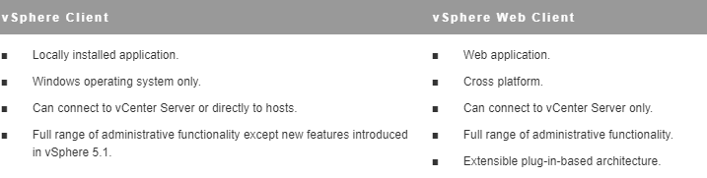
Differences between vSphere Client and vSphere Web Client

Slide 3
Accessing vSphere Web client
You can access Vsphere web client through a web browser connected to a vCenter server system.

Slide 4
Client Integration Plug-in
The Client Integration Plug-in provides access to a virtual machine’s console in the vSphere Client and provides access to other vSphere infrastructure features.
You can also use the Client Integration Plug-in to connect virtual devices that reside on a client computer to a virtual machine.
Install the Client Integration Plug-in only once to enable all the functionality the plug-in delivers. You must close the web browser before installing the plug-in.

Slide 5
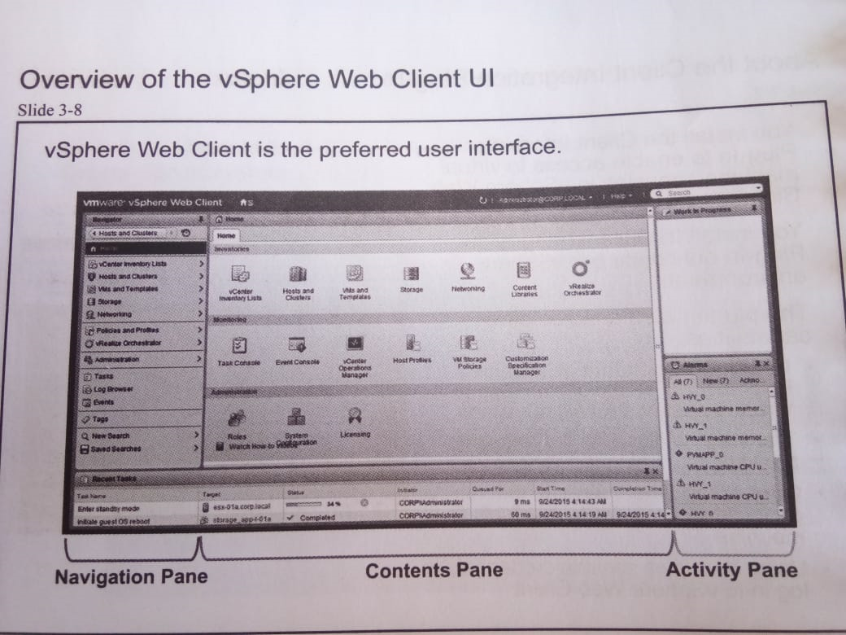
overview of the vSphere Web Client UI

Slide 6
The vSphere web client UI includes organizational panes that make presentation of information understandable.
Navigation pane: You use the navigation pane for selecting to Vmware objects.
Contents pane: You use the navigation pane for viewing, managing and monitoring Vmware objects.
Activity pane: you use the activity pane for viewing tasks and alarms.
Vsphere web client is the only UI that can use all the features in the current release of vSphere

Slide 7
Changing the appearance of vSphere Web Client
You can customize the user interface of vSphere Web Client by choosing to hide or display different sidebars.
Procedure
In a Web browser, log in to vSphere Web Client.
Click the user name at the top of the vSphere Web Client window and select Layout Settings.
In the Layout Settings window, select the sidebars that you want the UI to display.
Click OK to save the changes.

Slide 8
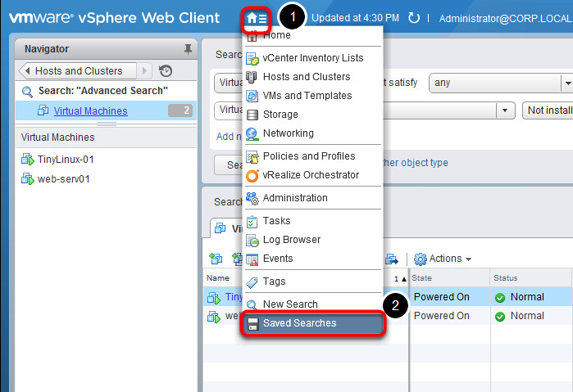
Displaying the objects in the navigation pane

Slide 9
The vSphere web client navigation pane organizes objects by use.
The navigation pane breaks the traditional hierarchical view of an object. Objects are linked and displayed by relationships:
The navigation pane enables an administrator to view objects by solutions.
It enables administrator to jump to crucial elements faster through relationships and searches on objects.
It reduces the client cluster and repetitive information by simplifying the display of objects.

Slide 10
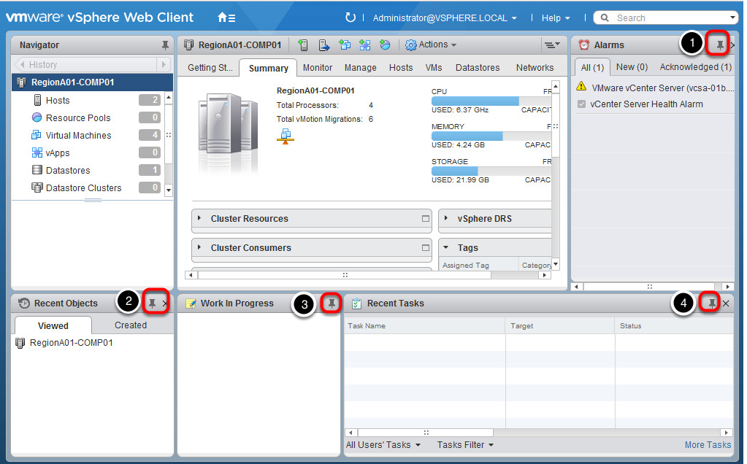
Viewing object information in the contents pane

Slide 11
You can view and manage properties for a selected object in the contents pane.
The contents pane provides a clear view of object properties and easy access to related objects.
Viewing recent activity in the activity pane
You can view recent activity pane of vSphere web client:
You can display all, running or failed tasks.
The activity pane shows running tasks.
The activity pane provides easy viewing of alarms.

Slide 12
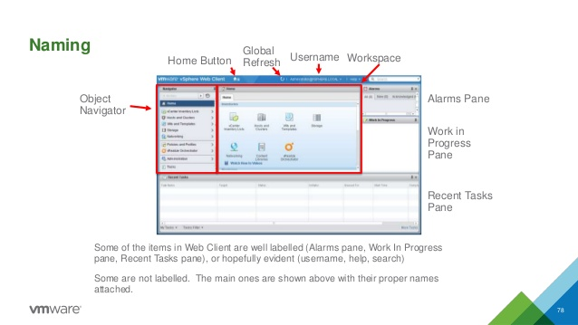
Viewing recent activity in the activity pane

Slide 13
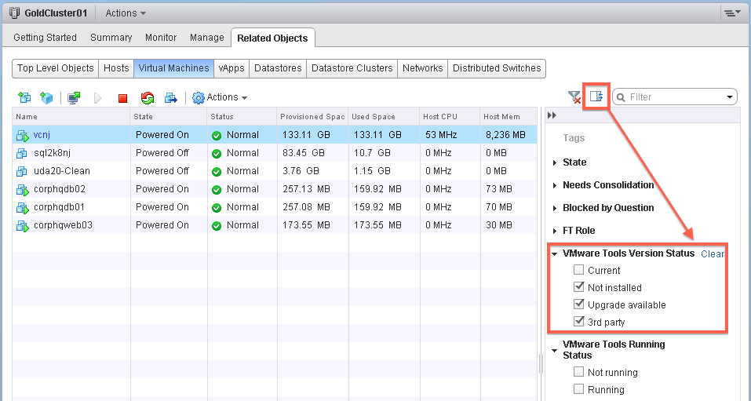
Using Quick Filters

Slide 14
Various types of quick filters are available for the vSphere objects in your inventory.
Tags are a quick filter option available for all types of vSphere objects.
You can filter data centers, vApps, and resource pools only by using the tags that are assigned to them. For datastores, clusters, hosts, virtual machines, and VM templates, you can use a number of different quick filters.
Quick Filters for Datastores
You can filter datastores by the following criteria:
Tags
Type
Belongs to Datastore Cluster
Accessibility
Maintenance Mode
Drive Type
% Free Space
Storage I/O Control

Slide 15
Viewing recently visited and created objects
In the Recent Objects pane, you can see a history of the most recent objects that you visited in your environment. You can see the most recent objects that you visited and the latest objects that you created. The recent objects list is persistent between vSphere Web Client sessions, but the new objects list is not persistent between vSphere Web Client sessions.
Procedure
In the Recent Objects pane, select the tab that you want to view.
Objects are listed in two tabs depending on whether you visited or created the object.
Tab Description
Viewed The last objects that you visited in the vSphere Web Client inventory.
Created The latest objects that you created in the vSphere Web Client inventory.
Click the object that you want to view.
The object displays in the center pane of the vSphere Web Client

Slide 16
Searching in vSphere Web Client
With vSphere Client, you can search the inventory for objects that match specified criteria.
You can only view and search for inventory objects that you have permission to view.
You can perform the following types of searches
Perform a Quick Search A quick search checks all types of objects for the specified search term within the name or other properties of the object.
Perform a Simple Search A simple search checks all types of objects for a specified search term within the object name.
Perform an Advanced Search You can conduct an advanced search in the vSphere Web Client to search for managed objects that meet multiple criteria.
Save, Run, Rename, and Delete a Search You can save search queries in the vSphere Client so you can rerun, rename, or delete them later.

Slide 17
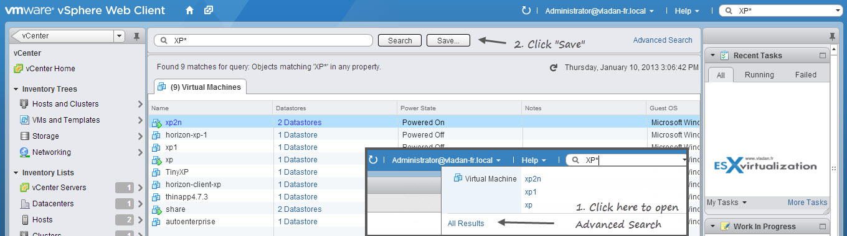

Slide 18
Saving a search and Loading a Saved Search
Procedure
In the vSphere Client, enter a query for either a simple or advanced search.
On the search results page, click Save Search.
Enter a name for the search query. Names must be lowercase with no spaces. Click SaveThe search query you entered is saved. You can reload the query later and repeat the search.
To run a saved search, go to the quick search field and click the saved search icon. Select the search query you want to run.

Slide 19
Dragging objects to New Inventory Locations
You can select an inventory object, and while holding the left mouse button you can drag it to another object. Drag is an alternative way to initiate operations that are available in the context menu, such as Move To and Migrate.

Slide 20
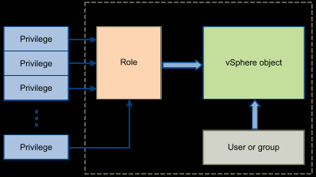
User roles and permissions

Slide 21
The permission model for vCenter Server systems relies on assigning permissions to objects in the vSphere object hierarchy. Each permission gives one user or group a set of privileges, that is, a role for the selected object.
The following concepts are important.
Permissions: Each object in the vCenter Server object hierarchy has associated permissions. Each permission specifies for one group or user which privileges that group or user has on the object.
Users and Groups: On vCenter Server systems, you can assign privileges only to authenticated users or groups of authenticated users. Users are authenticated through vCenter Single Sign-On. The users and groups must be defined in the identity source that vCenter Single Sign-On is using to authenticate. Define users and groups using the tools in your identity source, for example, Active Directory.

Slide 22
Privileges: Privileges are fine-grained access controls. You can group those privileges into roles, that you can then map to users or groups.
Roles: Roles are sets of privileges. Roles allow you to assign permissions on an object based on a typical set of tasks that users perform. Default roles, such as Administrator, are predefined on vCenter Server and cannot be changed. Other roles, such as Resource Pool Administrator, are predefined sample roles. You can create custom roles either from scratch or by cloning and modifying sample roles.

Slide 23
Assigning Permissions
Permissions are access roles that consist of a user and the user’s assigned role for an object such as a virtual machine or ESXi host. Permissions grant users the right to perform the activities specified by the role on the object to which the role is assigned.
For example, to configure memory for the host, you must grant a role to a user that includes the Host.Configuration.Memory Configuration privilege. By assigning different roles to users for different objects, you control the tasks that users can perform in your vSphere environment.
Users other than root and vpx user initially have no permissions on any objects, which means they cannot view these objects or perform operations on them. A user with Administrator privileges must assign permissions to these users to allow them to perform tasks.

Slide 24
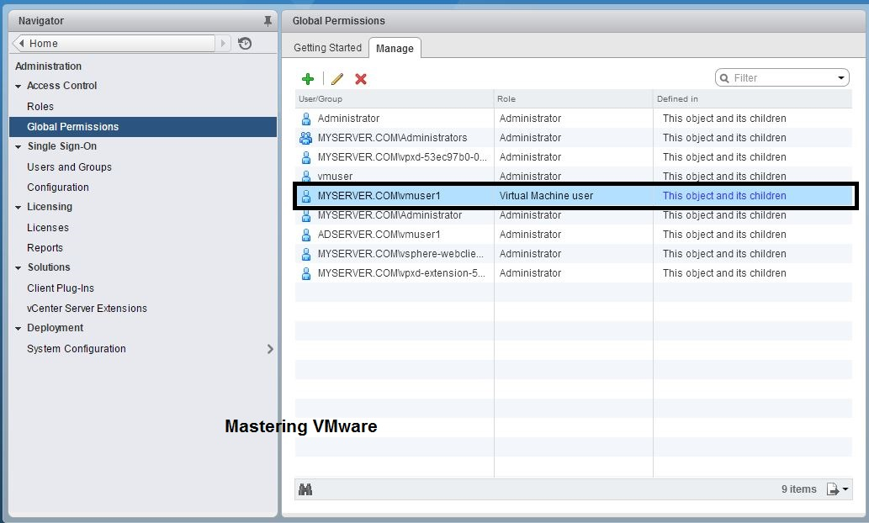

Slide 25
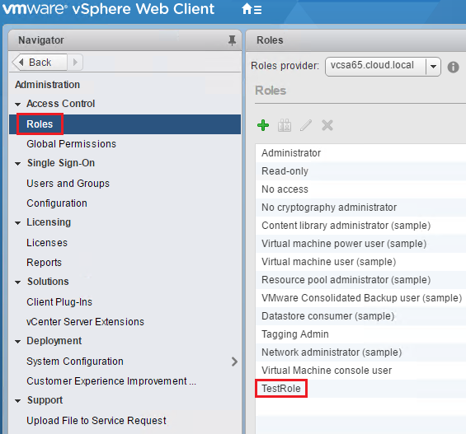
Viewing Roles and Permissions

Slide 26
The roles option in vSphere in vSphere web client web client shows the role assigned to a user for a particular object.
The right pane of the Roles page shows each object to which the role is assigned and the users and groups who are granted the role.

